Slide 1

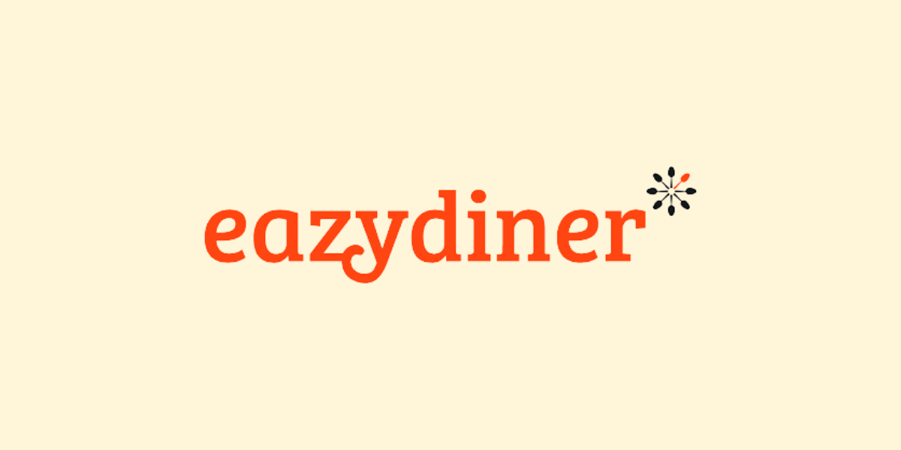
Title: Web Scraping and Exploratory Data Analysis of Eazydinner

Slide 2
About Me:
Iam K.Uday Shankar B.Tech graduate passionate about Data Analytics and Visualization.
Why Data Science ?
Data science is shaping the future of almost every field — from business and healthcare to entertainment and sports. By learning data science, I can open doors to diverse opportunities and contribute to data-driven innovations in whichever industry I work in.

Slide 3
Introduction:
Overview:
The dataset was created by web scraping hotel and restaurant listings from an online platform using Python libraries such as BeautifulSoup and Requests.
It contains 1350 entries representing different hotels and restaurants located in Delhi.
Each record captures essential business information such as hotel name, pricing, rating, cuisine type, and discount details.
This data provides valuable insights into pricing patterns, customer preferences, and competitive offerings in Delhi’s hospitality sector.

Slide 4
Dataset Features:
Column Name | Description
Hotel_name | Name of the hotel or restaurant.
Price | Average cost for two people (text format, includes currency).
Rating | Average customer rating (numeric).
Type | Cuisine type or category (e.g., Multicuisine, North Indian).
Pagenum | Page number from which the data was scraped.
Original_price | Listed base price before discounts.
Discount | Active discount offers or promotional combinations.

Slide 5
Objectives:
To collect real-time data on hotel names, prices, ratings, cuisines, and discounts using Python web scraping tools (BeautifulSoup, Requests).
To clean and organize the scraped data into a structured dataset suitable for analysis.
To analyze pricing trends and customer ratings to identify popular cuisines and affordable options.
To gain insights into discount strategies and their potential impact on customer attraction.
To build a foundation for data-driven decision-making in hospitality analytics and marketing.

Slide 6
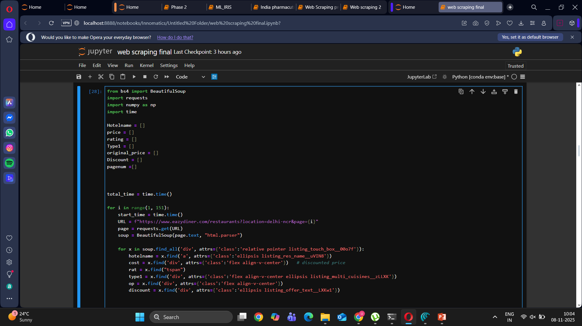
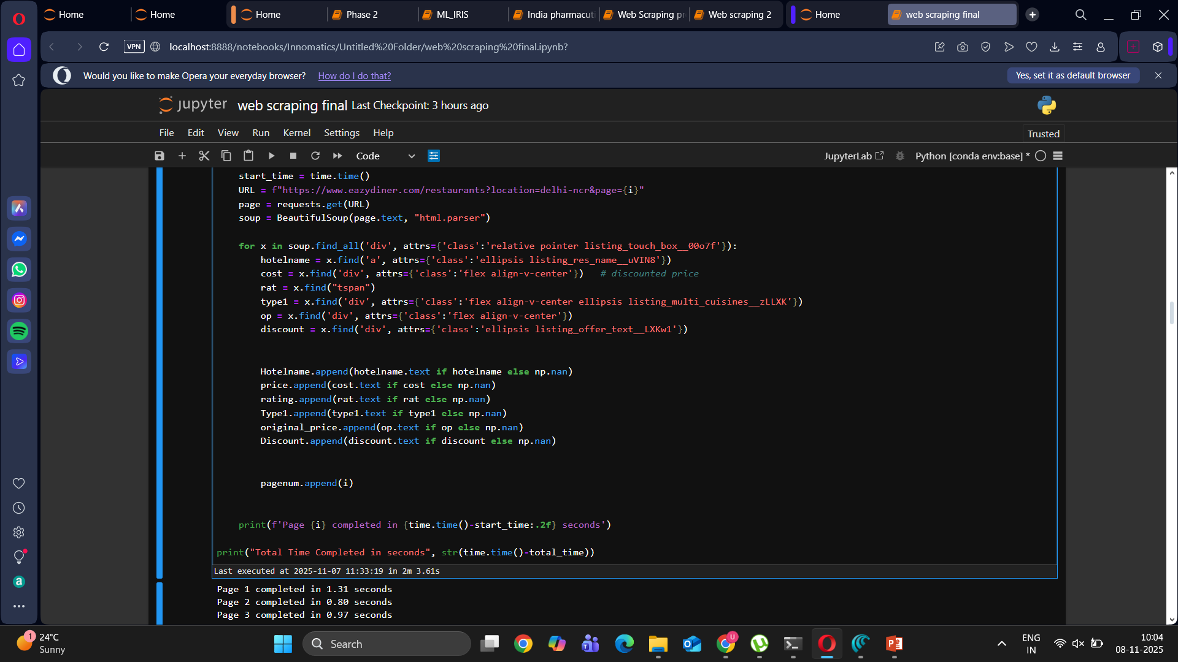
How I Performed Web Scraping:
Planning & Target Selection
Identified a travel/restaurant website containing relevant hotel data for Delhi.
Defined the data attributes to collect: Hotel name, Price, Rating, Type, Discount, and Page number.
Setup Environment
Used Python as the primary language.
Installed required libraries:
Data Extraction
Sent automated HTTP requests using the requests library to fetch HTML content.
Parsed the HTML using BeautifulSoup to extract tags containing hotel details (div, span, etc.).
Used loops to iterate through multiple pages (pagination).
Data Storage & Structuring
Stored extracted data into Python lists (Hotelname, Price, Rating, Type, etc.).
Combined them into a Pandas DataFrame for easy handling and analysis.
Data Cleaning & Preprocessing
Removed duplicate entries and handled missing values.
Standardized text columns and formatted price/rating values.
Added location and page number columns for tracking and segmentation.
Validation & Analysis
Cross-checked data accuracy with the source website.
Prepared the cleaned dataset for EDA (Exploratory Data Analysis) and visualization.

Slide 7






Tools Used:

Slide 8
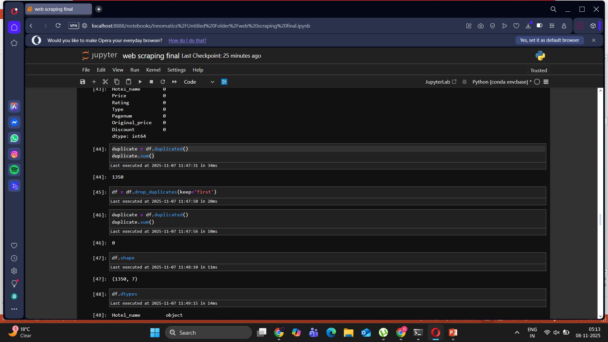
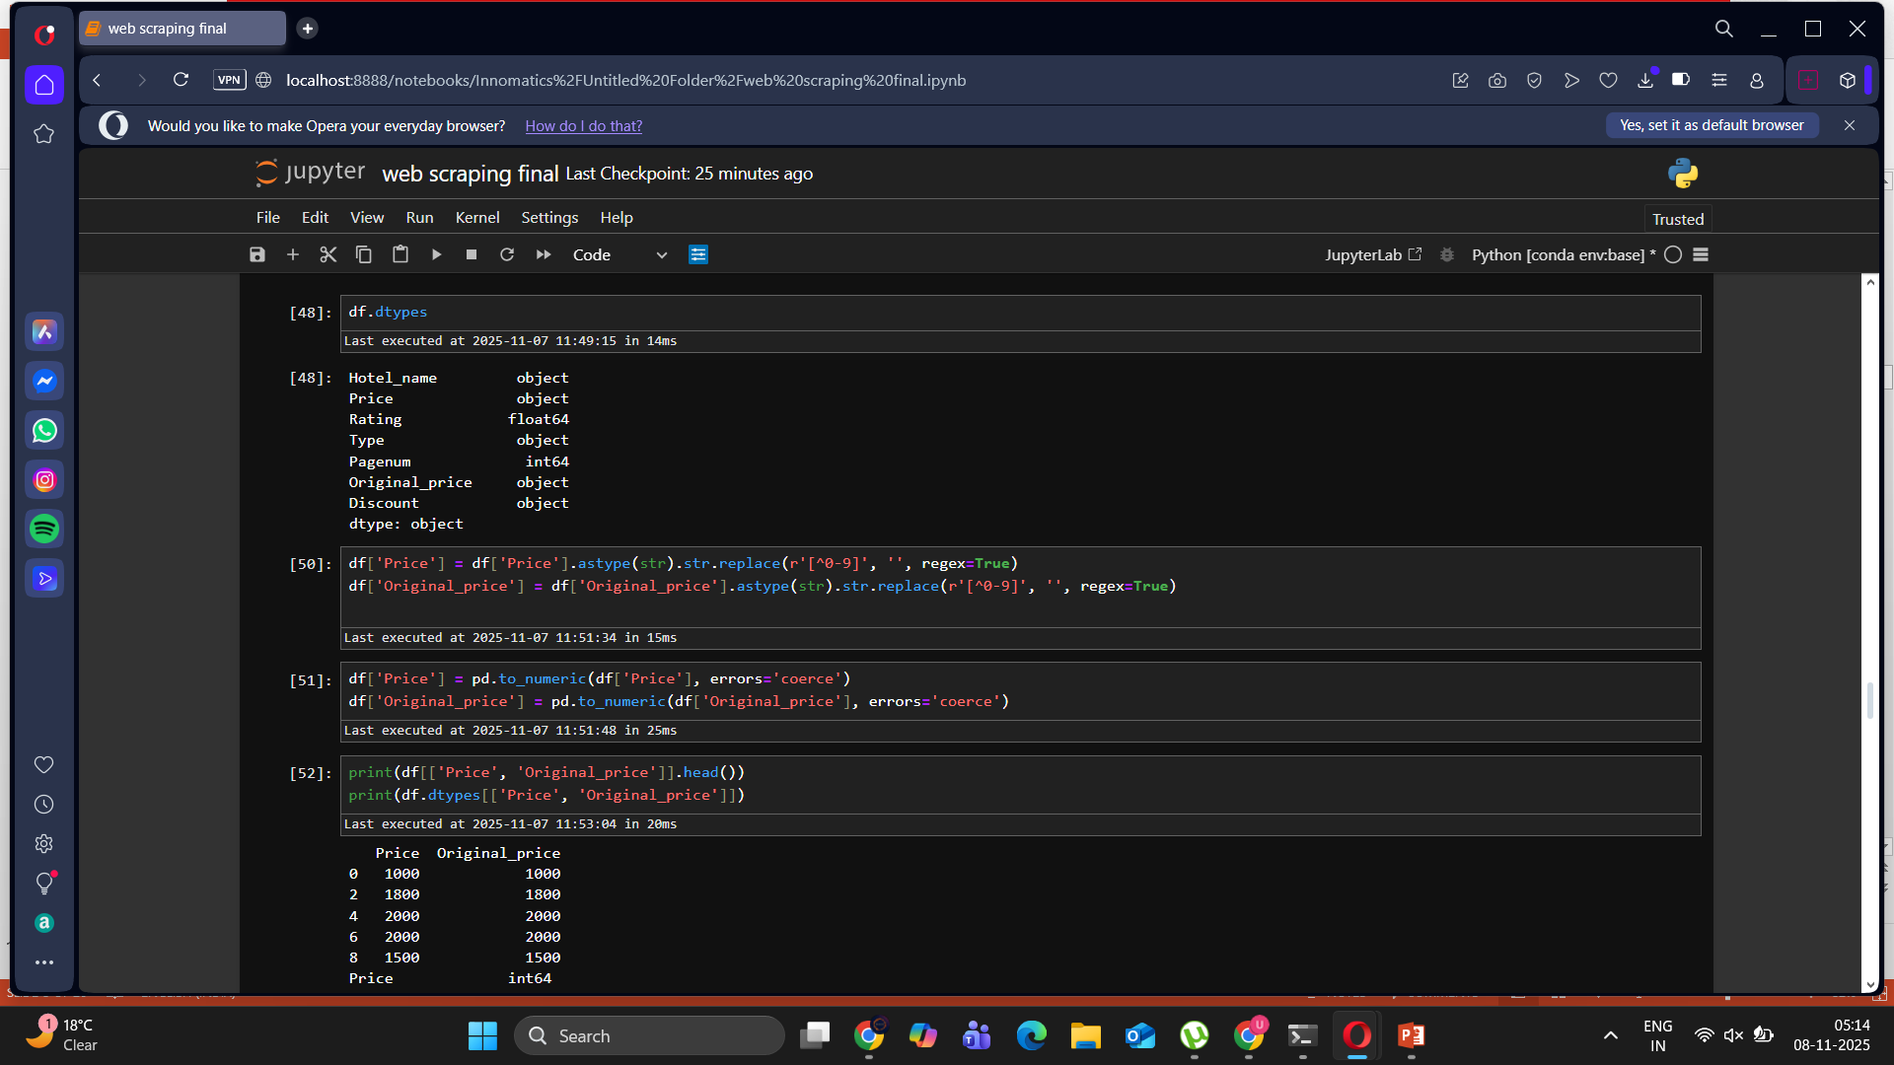
Data Cleaning Steps:
Removed duplicate entries to ensure only unique hotel and restaurant records remain.
Handled missing values by filling empty fields (like hotel type) with appropriate placeholders.
Cleaned the Price column by removing currency symbols and text to retain only numeric values.
Converted data types — changed price and rating columns from text (object) to numerical (float/int).
Standardized discount information to extract numeric percentages for better comparison.
Checked overall data consistency to ensure all columns have the correct format and valid entries.
Saved the cleaned dataset as a CSV file ready for analysis and visualization.

Slide 9
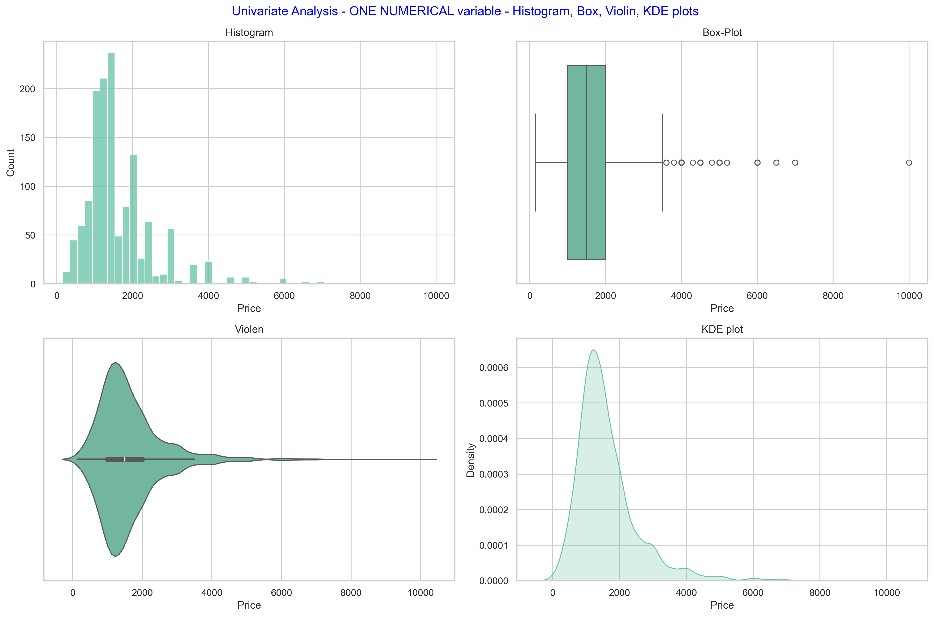
Data Visualization:Univariate Analysis
Key Observations:
The price distribution is right-skewed, meaning most hotels have lower or mid-range prices, while only a few are expensive.
The majority of prices fall between ₹500 to ₹2500, indicating this as the most common spending range.
The box plot shows several outliers, representing high-end or premium hotels.
The violin and KDE plots confirm a dense concentration of prices around ₹1500, tapering off gradually for higher ranges.

Slide 10
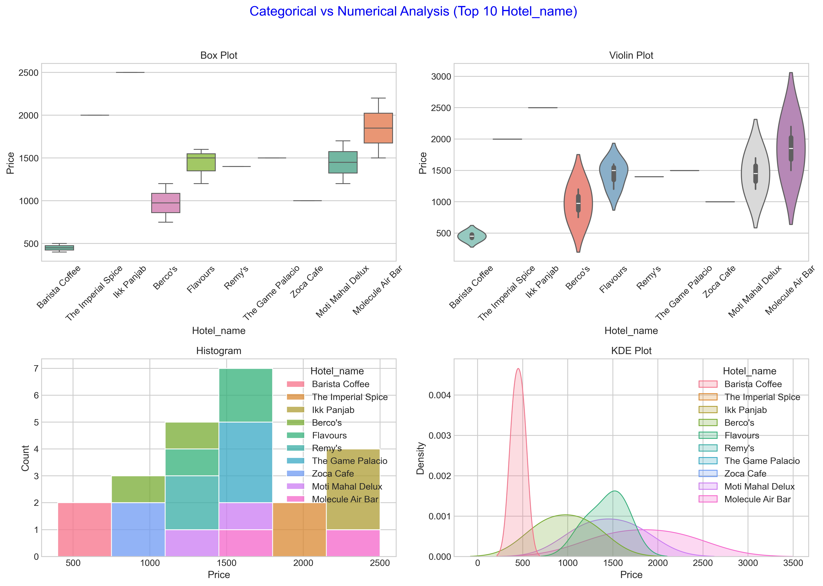
Data Visualization:Bivariate Analysis(categorical vs numerical
There is a clear variation in pricing across different hotel names.
Barista Coffee shows the lowest price range, indicating affordability and a café-style offering.
The Imperial Spice, Molecule Air Bar, and Moti Mahal Delux display higher average prices, representing premium or fine-dining restaurants.
Box and violin plots highlight significant price dispersion, especially for luxury restaurants with varied menu pricing.
Histogram and KDE plots show that mid-range hotels (e.g., Berco’s, Flavours, Zoca Café) have moderate, consistent prices around ₹1200–₹1800.
The data reflects a diverse pricing structure — from budget cafés to upscale dining experiences.

Slide 11
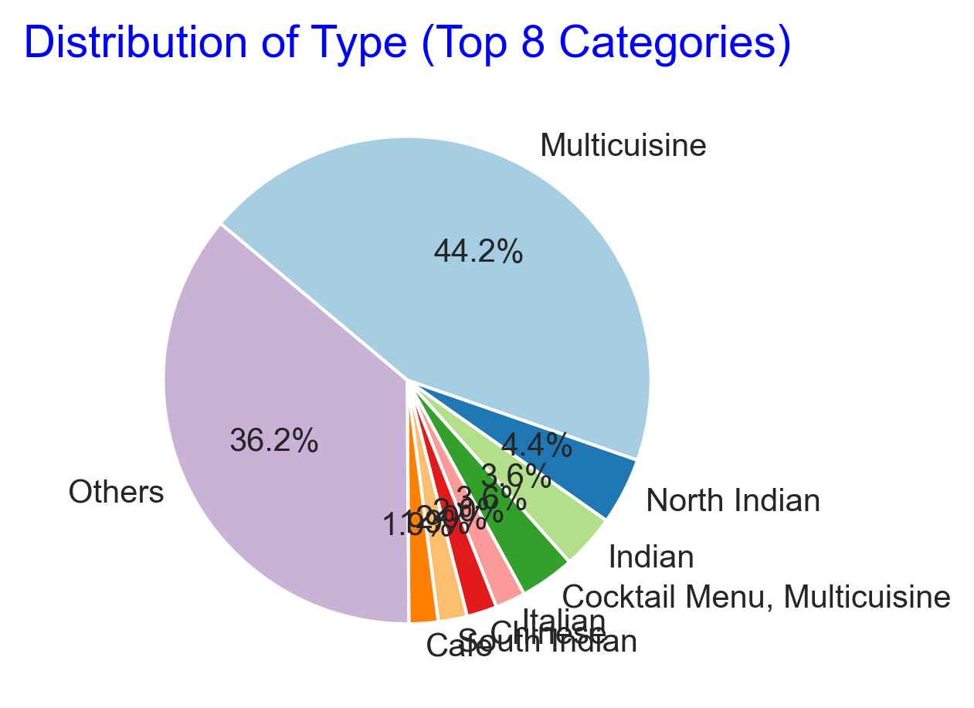
Data Visualization:Pie Chart
Multicuisine restaurants dominate the dataset, making up 44.2% of all listings — indicating that most establishments offer a variety of cuisines.
Others category accounts for 36.2%, covering unique or mixed types not part of the top 8 categories.
North Indian (4.4%) and Indian (3.6%) cuisines are the next most common, showing strong local food preferences.
Smaller proportions include Cocktail Menu (3.6%), Chinese (3%), Italian (2.9%), and South Indian (1.9%).
The data suggests that Delhi’s restaurant market is highly diverse, with a major focus on multi-cuisine dining experiences catering to a broad audience.

Slide 12
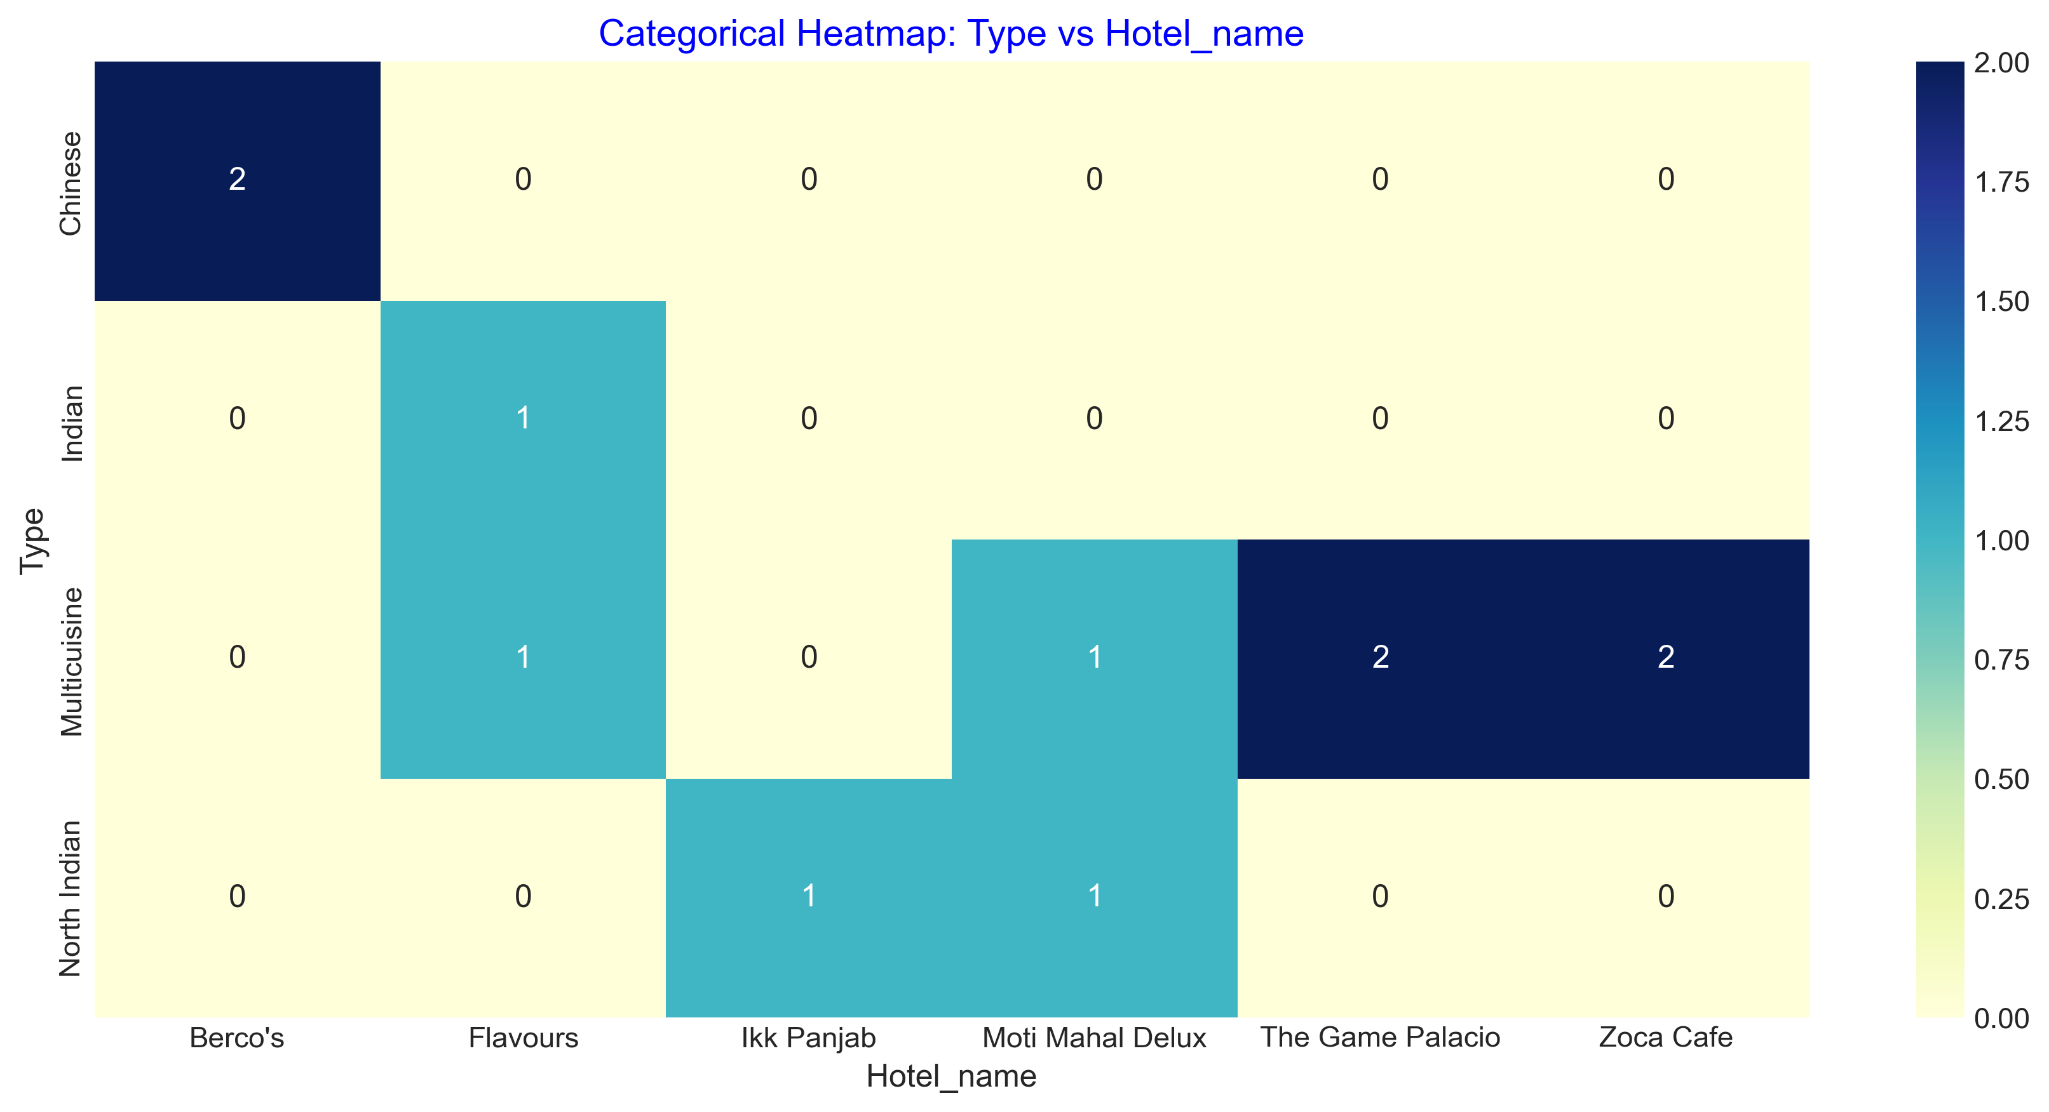
Data Visualization:Heatmap
The heatmap highlights which hotels specialize in which cuisine types.
Multicuisine appears most frequently across several hotels, confirming it as the dominant offering in Delhi’s restaurant market.
Some hotels (like Molecule Air Bar, Moti Mahal Delux) show strong intensity, indicating a focused or well-represented cuisine type.
Lighter shades in the heatmap represent hotels with less common or specialized cuisines.
The visualization helps identify patterns of cuisine popularity and diversity among hotels.
It provides a quick view of overlapping offerings, where multiple hotels serve similar cuisine categories.

Slide 13
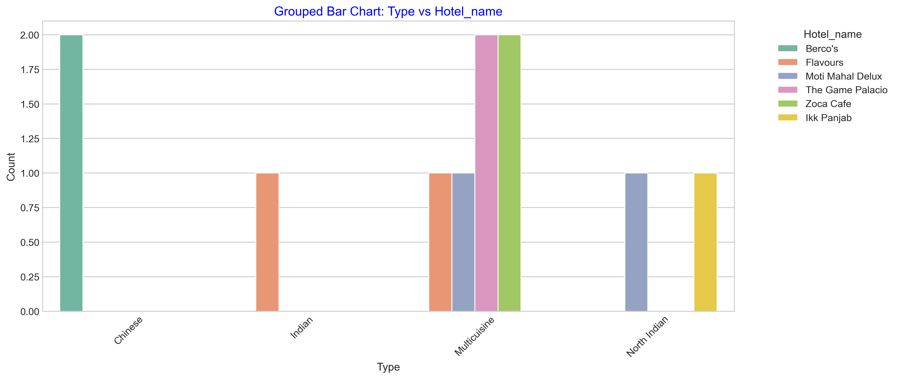
Data Visualization:Grouped Bar chart
The grouped bar chart highlights the variety of cuisines offered by each hotel or restaurant.
Multicuisine is the most common type served across multiple hotels, showing a broad and versatile offering trend.
Some hotels focus on specific cuisines (e.g., North Indian or Chinese), reflecting specialized dining experiences.
Hotels such as The Imperial Spice and Moti Mahal Delux show strong representation in premium cuisines, indicating a fine-dining focus.
Smaller or café-style restaurants (like Barista Coffee) are limited to fewer cuisine types, suggesting a niche target market.
The visualization helps in identifying diverse vs specialized hotels, and how they position themselves in Delhi’s restaurant market.

Slide 14
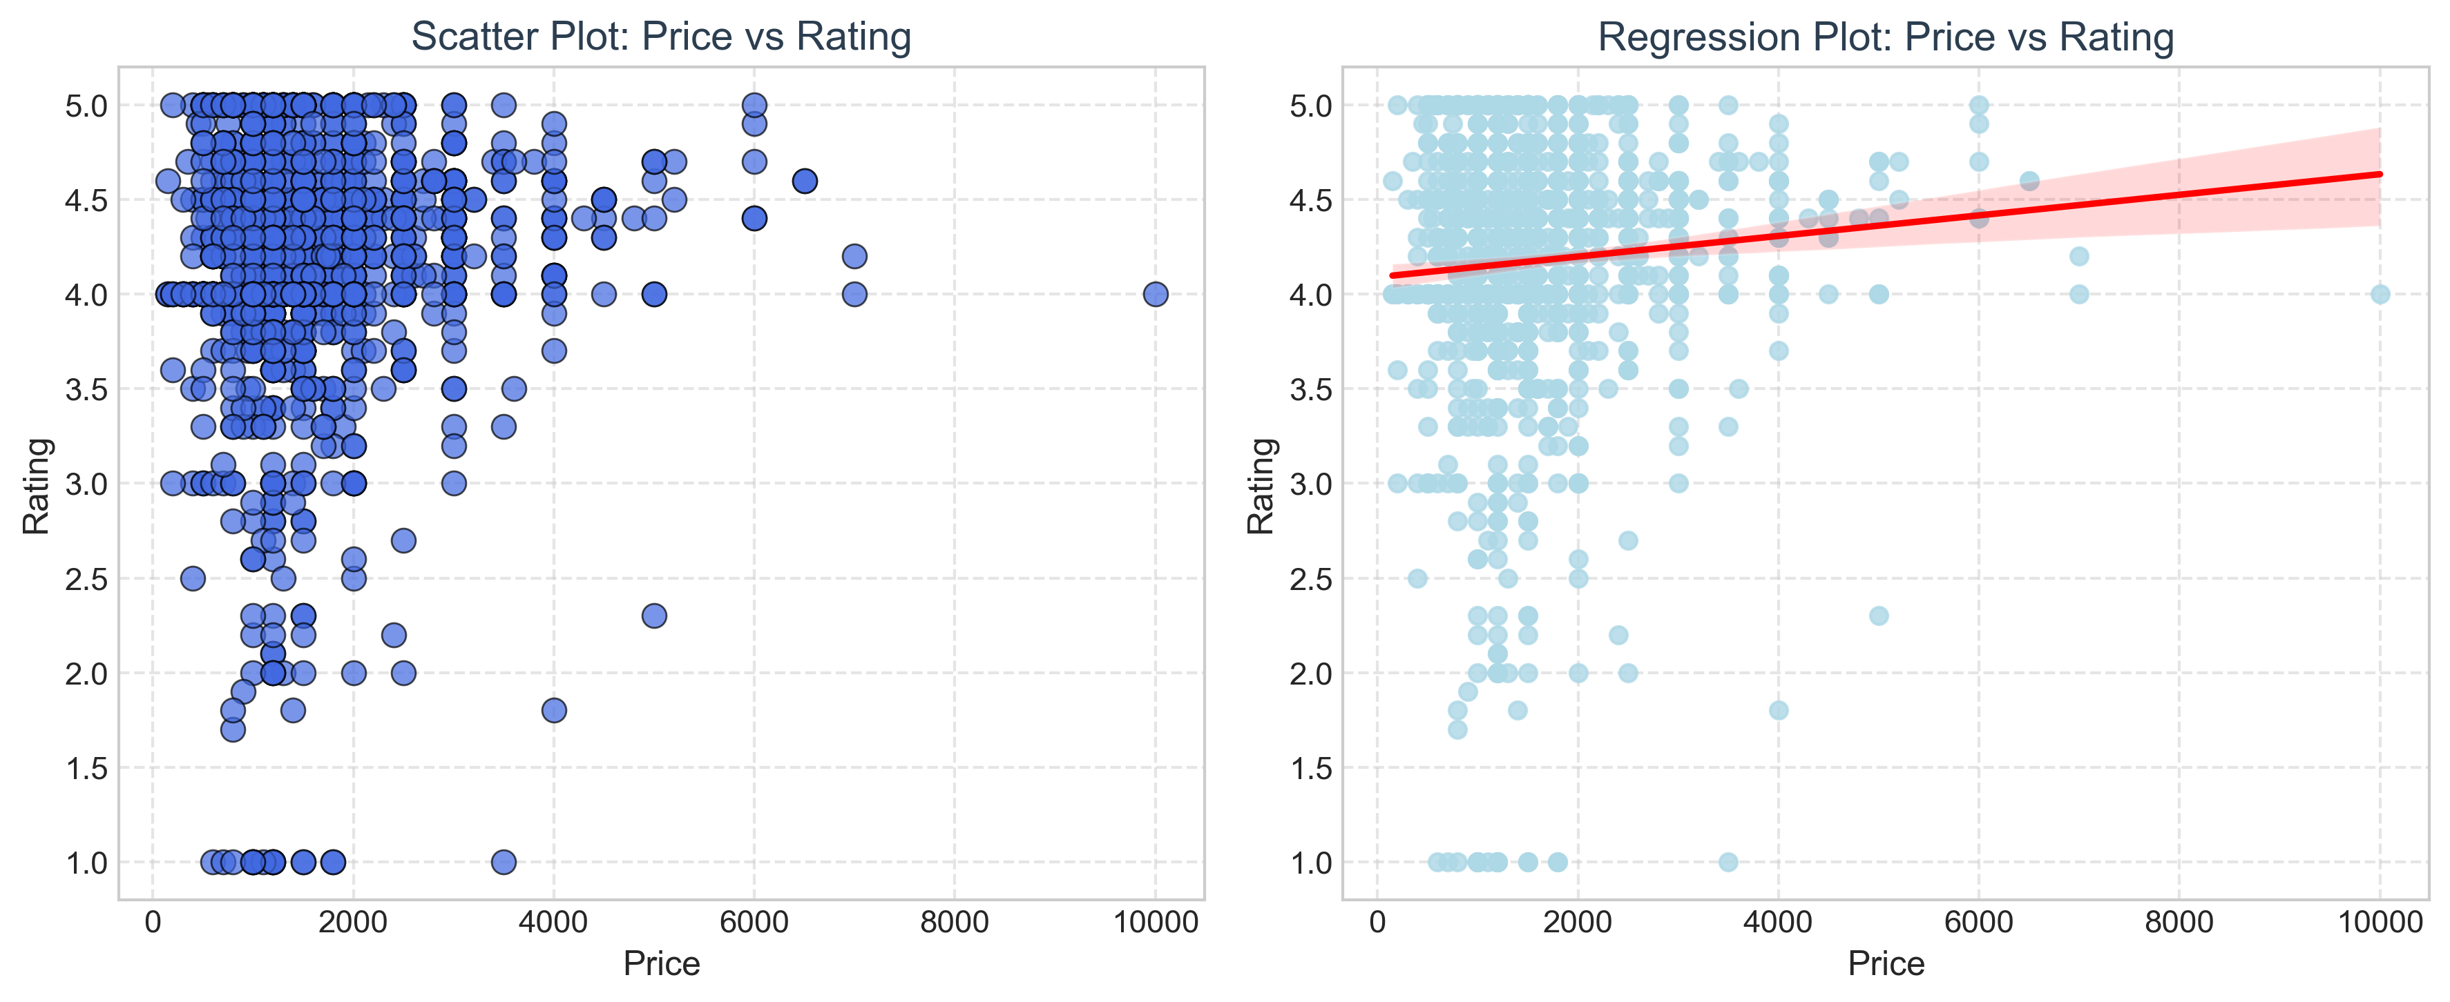
Data Visualization:
The scatter plot shows a wide spread of data points, indicating no strong linear relationship between price and rating.
Most hotels with moderate prices (₹1000–₹2500) tend to receive consistent ratings between 4.0–4.5, showing that affordability doesn’t compromise quality.
A few high-priced hotels achieve higher ratings, suggesting premium experiences are recognized positively by customers.
Some low-rated yet high-priced points may represent overpriced services or unmet customer expectations.
The regression line shows a slight positive trend, indicating that higher prices are loosely associated with higher ratings, but the relationship is weak.
Overall, factors other than price (like service quality, ambiance, and food variety) likely influence ratings more strongly.

Slide 15
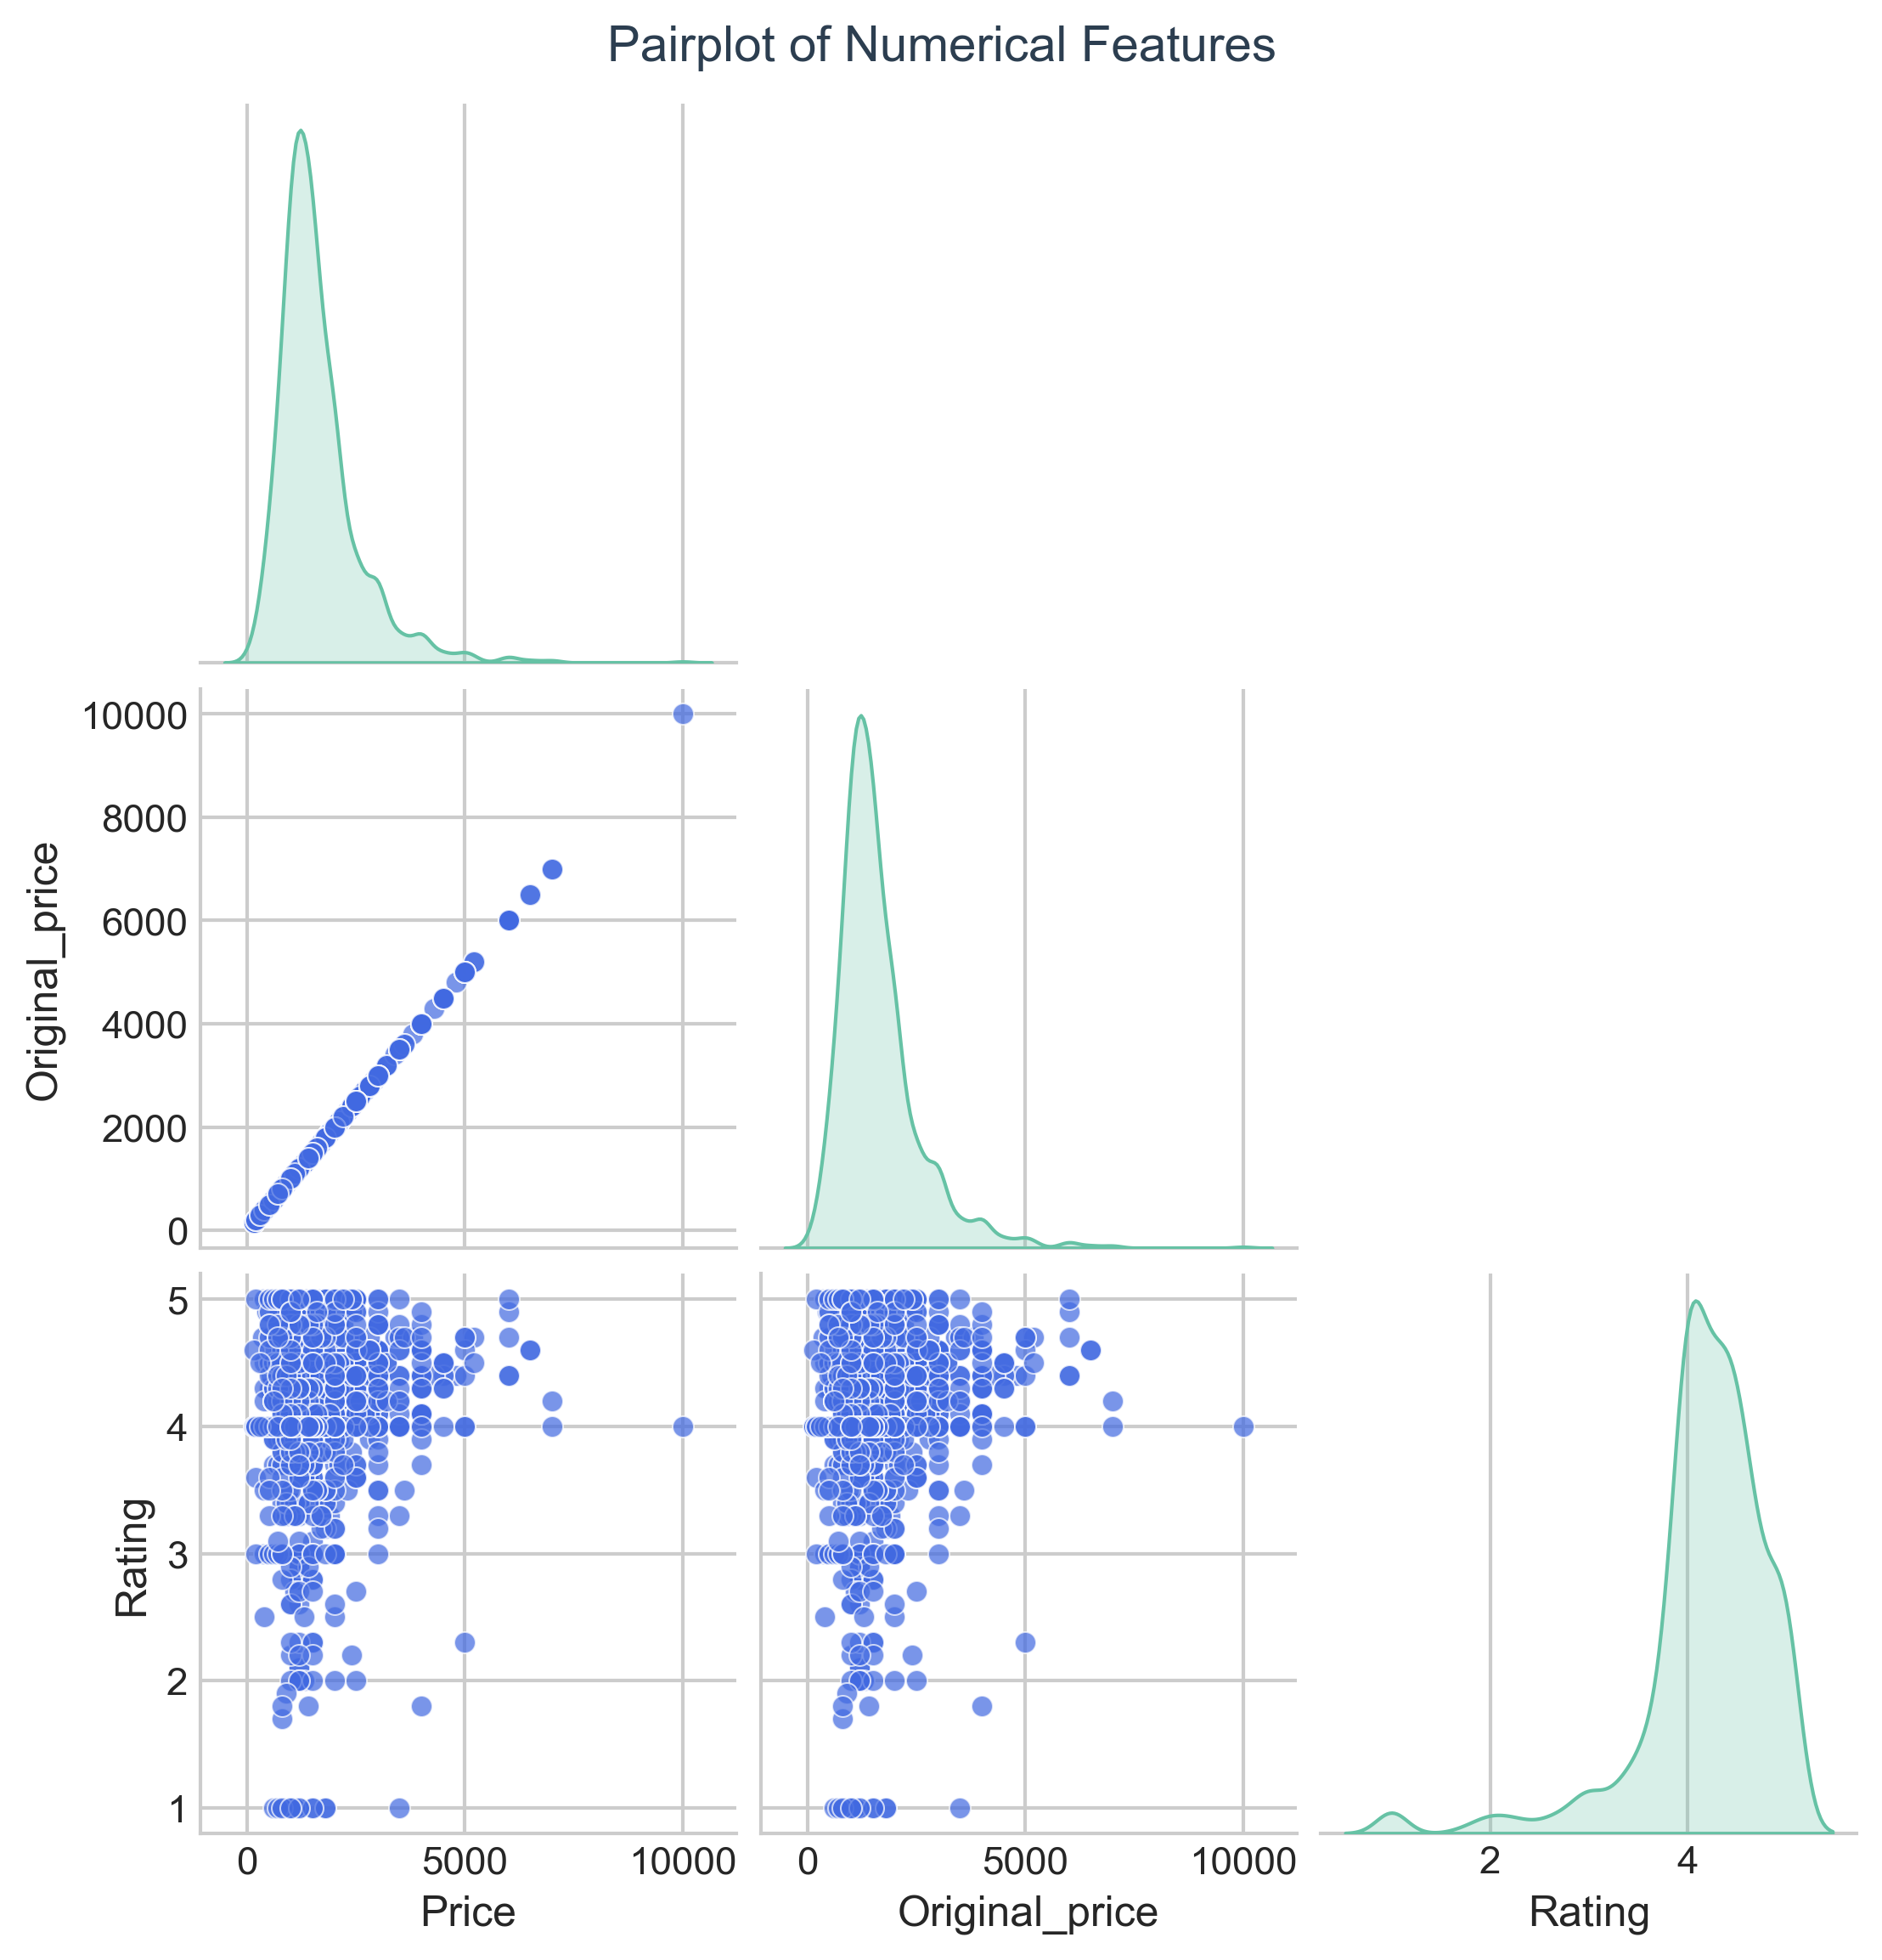
Data Visualization:Pair plot
The pair plot shows positive correlation between Price and Original Price, indicating that discounted prices follow a similar trend to listed prices.
Higher original prices generally correspond to higher current prices, showing that premium hotels maintain consistent pricing structures even after discounts.
The relationship between Price and Rating is weak or scattered, suggesting that customer ratings are not directly tied to hotel pricing.
The Rating vs Original Price plot also shows no strong linear pattern, implying that expensive hotels do not always guarantee higher satisfaction.
The diagonal plots reveal the distribution of each variable — with Price and Original Price right-skewed (more budget hotels) and Rating concentrated around 4.0–4.5.
Overall, the visualization helps confirm which features are related and which act independently.

Slide 16
Key Business Questions
What is the most common price range for hotels and restaurants in Delhi?
Which cuisine types dominate the Delhi restaurant market?
How do hotel prices vary across different restaurant types and locations?
Is there a relationship between pricing and customer satisfaction (ratings)?
Which hotels or cuisines show overlapping or distinct market positions?

Slide 17
Conclusion:
What is the most common price range for hotels and restaurants in Delhi? Helps identify market affordability and the most competitive pricing segment (from the univariate price analysis).
Which cuisine types dominate the Delhi restaurant market? Determines which food categories (like Multicuisine or North Indian) are most popular, guiding new restaurant offerings (from the pie chart).
How do hotel prices vary across different restaurant types and locations? Reveals which cuisines or hotels operate in the premium vs budget segment (from bivariate and grouped bar charts).
Is there a relationship between pricing and customer satisfaction (ratings)? Assesses whether higher prices lead to better ratings or if mid-range hotels perform equally well (from scatter plot and regression analysis).
Which hotels or cuisines show overlapping or distinct market positions? Identifies competitive overlaps and specialization through heatmaps and pair plots, useful for positioning and differentiation.

Slide 18

Challenges Faced:
1. Dynamic Website Structure
The website’s HTML structure frequently changed, making it difficult to locate and extract consistent tags for hotel details.
Needed to adjust the scraping code several times to match new page layouts.
2. Pagination Handling
Extracting data across multiple pages (1–18) required loop management and error handling to avoid missing or duplicate records.
3. Inconsistent Data Formats
Price and discount fields contained symbols and text (e.g., “₹ 1500 for two approx.”), requiring extensive cleaning before analysis.
4. Missing and Duplicate Values
Some hotel records were repeated or incomplete, demanding data validation, deduplication, and imputation steps.
5. Encoding and Special Characters
Special characters like ₹, °, or “% Off” created issues during CSV export and required encoding fixes (UTF-8 handling).
6. Data Visualization Challenges
Cleaning and converting text-based numerical columns into proper data types before creating accurate visualizations.

Slide 19


